Slide 1
Migrating to Redmine
Harry Garrood
Halarose Ltd
26 June 2012

Slide 2
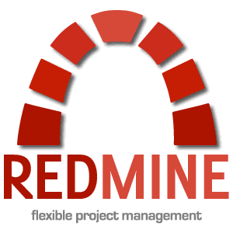
What I did

Slide 3

Why track bugs?
Bugs should never be forgotten about
Versions
Support
Management

Slide 4
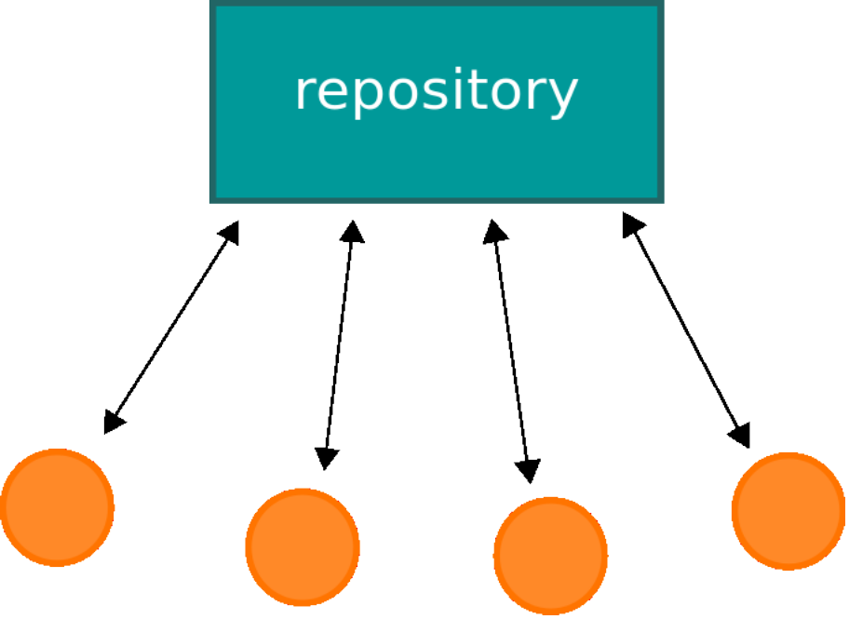
Benefits
Integration with other tools
  Apache Subversion

Slide 5

Benefits
Integration with other tools
  Jenkins

Slide 6
Benefits
Searching and querying
Notifications
Release notes

Slide 7
Summary

